Slide 1
High Level Programming
project 1

Slide 2
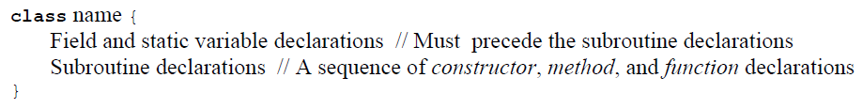
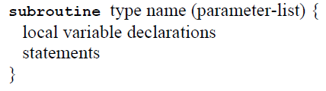
Program Structure
The basic programming unit in Jack is a class.
All subroutine declarations have the following format:
Notes:
Each class declaration specifies a name through which the class can be globally accessed. Next comes a sequence of zero or more field and static variable declarations. Next comes a sequence of one or more subroutine declarations, each defining a method, a functions, or a constructor.
Subroutine is either constructor, method, or function. Each subroutine has a name through which it can be accessed, and a type describing the value returned by the subroutine. If the subroutine returns no value, the type is declared void; otherwise it can be any of the primitive data types supported by the language, or any of the class types supplied by the standard library, or any of the class types supplied by other classes in the application. Constructors may have arbitrary names, but they must return an object of the class type.

Slide 3
As in Java, a Jack program is a collection of one or more classes. One class must be named Main, and this class must include at least one function named main. When instructed to execute a Jack program that resides in some directory, the Jack run-time environment will automatically start running the Main.main function.

Slide 4
Variables & Data Types
There are four kinds of variable:
fields
static
local
parameter
Jack features three primitive data types:
int
boolean
char
Every class defines an object type. As in Java, the declaration of an object variable causes only the creation of an reference variable (pointer).

Slide 5
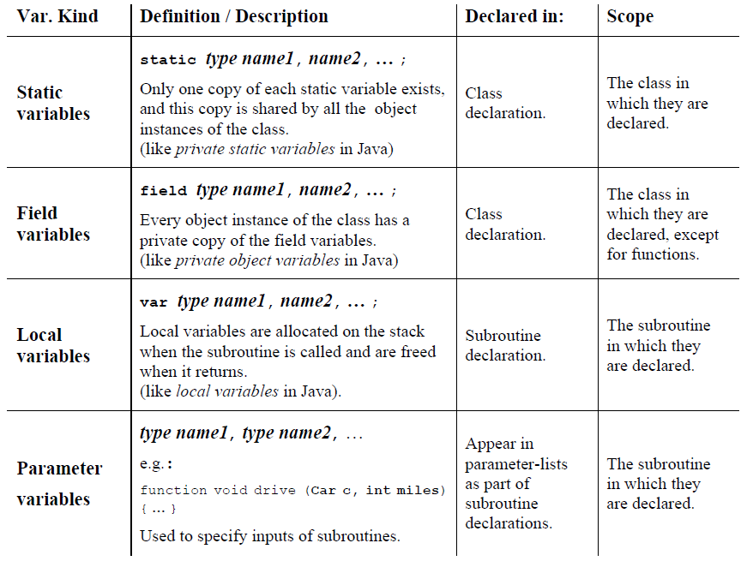

Slide 6
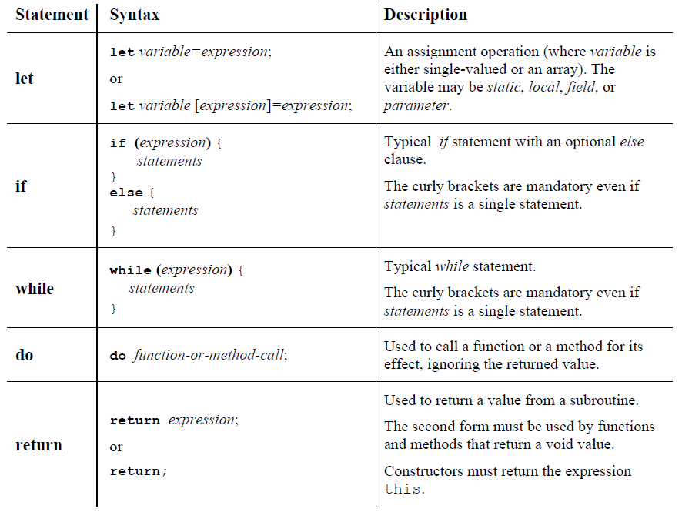
Statements
Notes:
The Jack language features five generic statements.

Slide 7
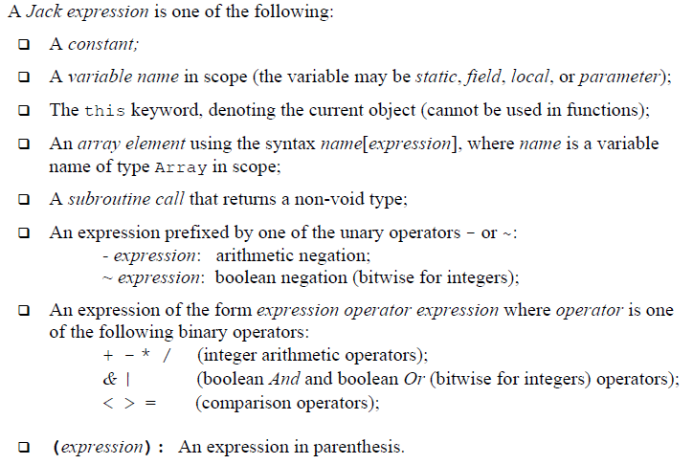
Expressions
Notes:
Operator priority is not defined by the language, except that expressions in parentheses are evaluated first.

Slide 8
Subroutine calls
Subroutine calls invoke methods, functions, and constructors.
General syntax :
subroutineName(argument-list)
Within a class, methods are called using the syntax:
methodName(argument-list)
Outside a class, methods are called using the syntax:
varName.methodName(argument-list)
Functions and constructors must be called using their full-names:
className.subroutineName(argument-list)

Slide 9
Object Construction and Disposal
Constructors may have arbitrary names, but it is customary to call one of them “new”. Constructors are called just like any other class function using the format :
let <var> = <class_name>.<constructor_name>(<parameter_list>);
Objects can be de-allocated from memory and their space reclaimed using the Memory.deAlloc(object), from dispose() method that exists in every class.

Slide 10
The Jack Standard Library
Built-in classes :
Math: Provides basic mathematical operations;
String: Implements the String type and string-related operations;
Array: Implements the Array type and array-related operations;
Output: Handles text output to the screen;
Screen: Handles graphic output to the screen;
Keyboard: Handles user input from the keyboard;
Memory: Handles memory operations;
Sys: Provides some execution-related services.

Slide 11
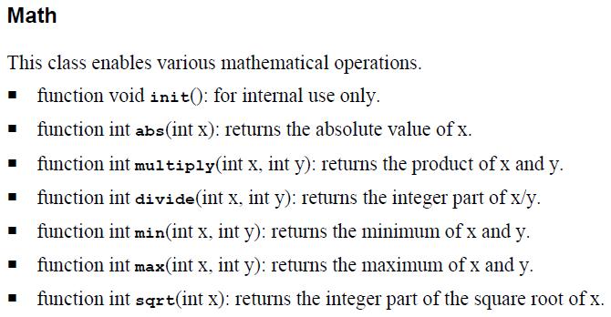
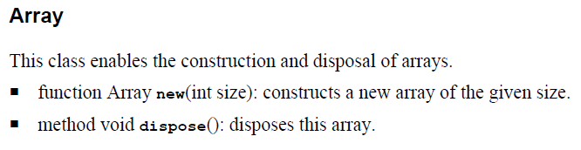

Slide 12
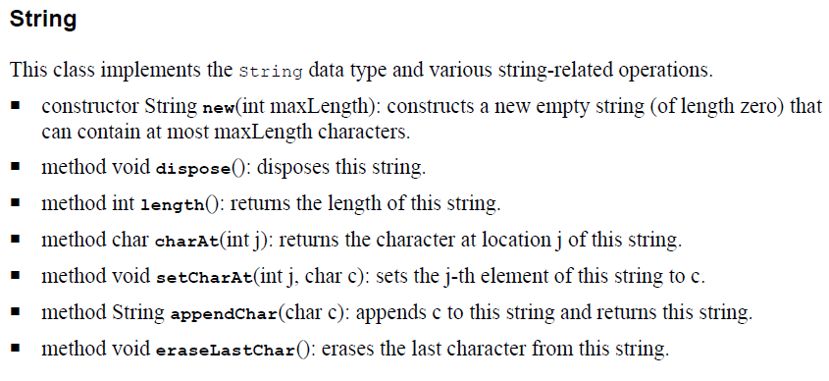
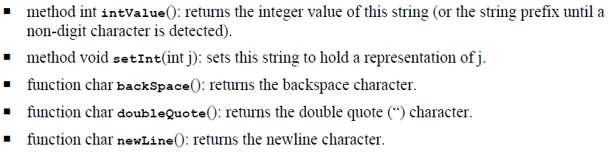

Slide 13
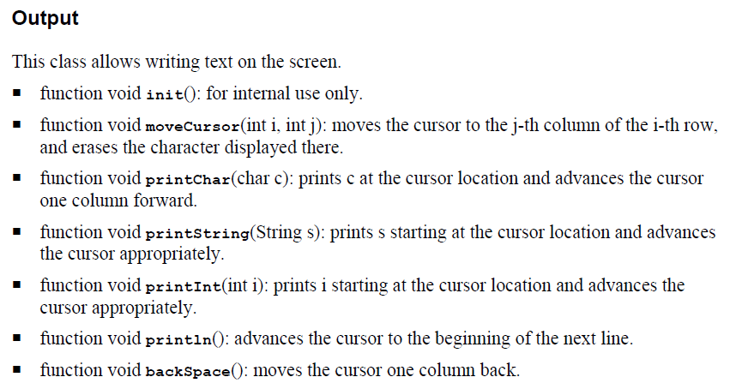

Slide 14
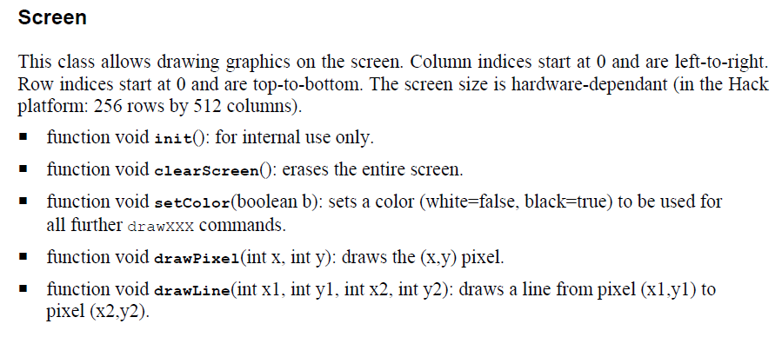
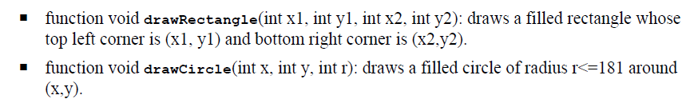

Slide 15
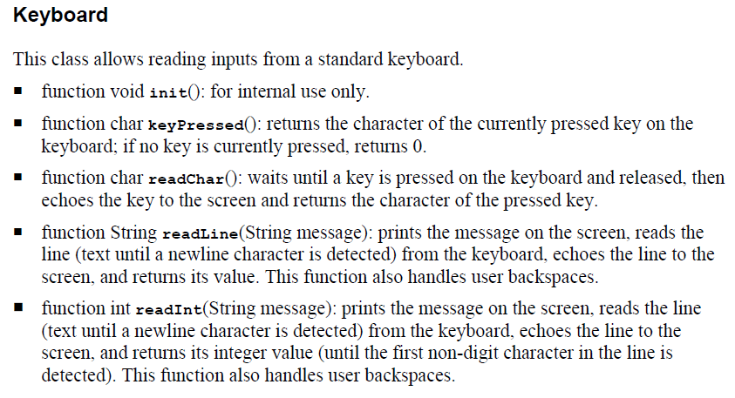

Slide 16
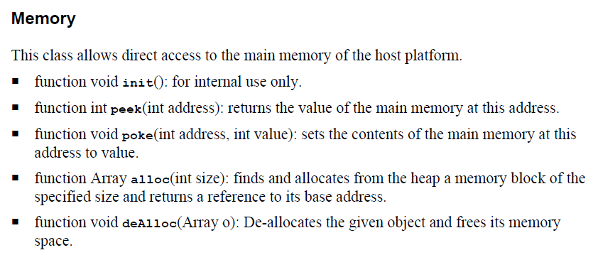
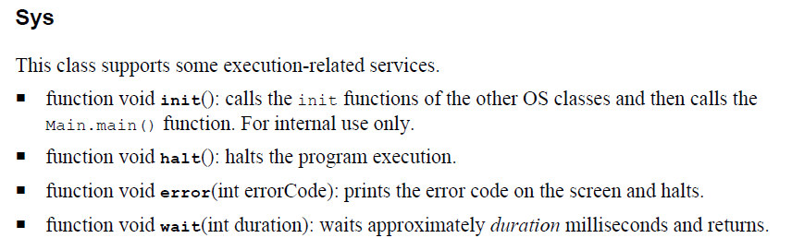

Slide 17
Compiling and Running a Jack Prog.
Resources: You will need three tools: the Jack compiler, the VM Emulator, and the Jack Operating System.
Each program must be stored in a separate directory Xxx. Then copy all the files from tools/OS into the Xxx directory.
Write your Jack each stored in a separate ClassName.jack text file, in the Xxx directory.
Compile your program ,using the supplied Jack compiler, by applying the compiler to the name of the program directory (Xxx). The compiler will translate all the .jack classes found in the directory into corresponding .vm files.
To test the compiled program, invoke the VM Emulator and load the entire Xxx program directory. Then run the program.
Notes:
the Jack compiler- to translate your program into a set of .vm files
the VM Emulator-to run and test your program

Slide 18
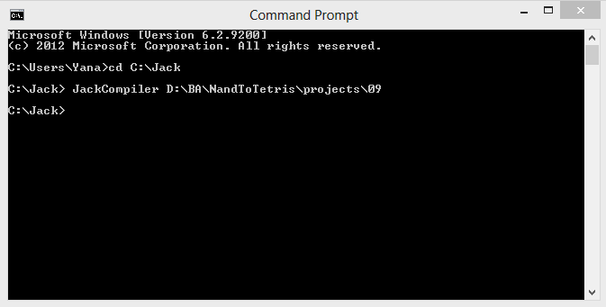
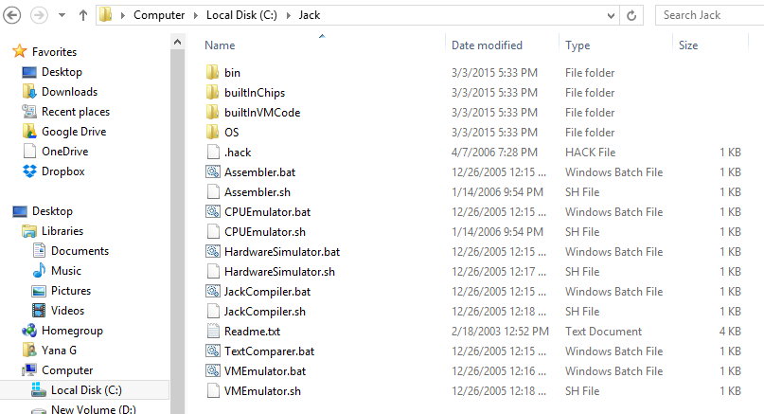
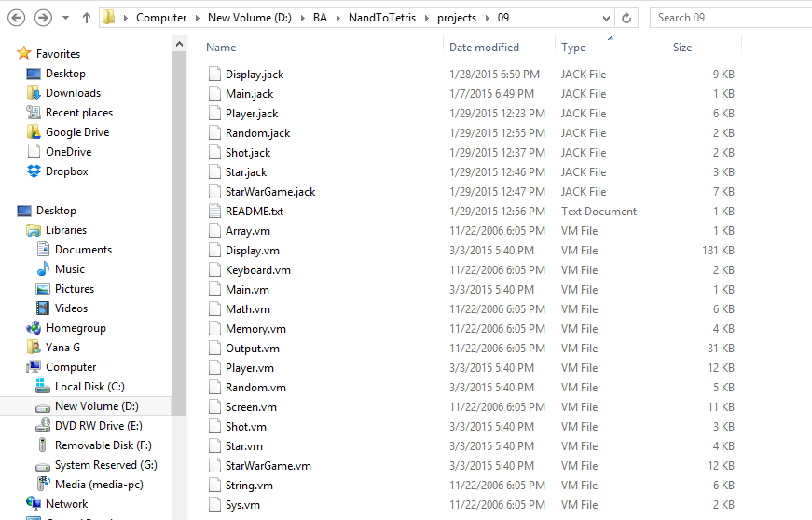

Slide 19
How and what to submit
Create a folder named 2015B_exXX_YYYYYYYY, when XX is the ex number, and YYYYYYYY is your ID.
For example: 2015B_ex01_320457807.zip
All submission files should be in that folder, and no other extra file. Files to submit: jack files, README.txt
Zip the folder to a zip file named 2015B_exXX_YYYYYYYY.zip

